Slide 1

Student Details
NAME: VARUN DATTU RAJAPURE
EMAIL ID: rajapurevarun@gmail.com
COLLEGE NAME: SHAH AND ANCHOR KUTCHHI ENGINEERING COLLEGE
COLLEGE STATE: MAHARASHTRA
INTERNSHIP DOMAIN AND INTERNSHIP START AND END DATE: ARTIFICIAL INTELLIGENCE/12-06-2023 TO 24-07-2023
CANDID PICTURE:

Slide 2
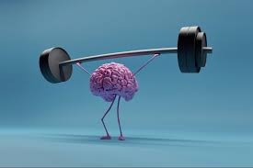
MENTAL FITNESS TRACKER
WHAT IS MENTAL FITNESS?
Mental fitness refers to the overall state of psychological well-being and the ability to cope with the various challenges and demands of life.
It encompasses a range of mental and emotional attributes that contribute to a person's resilience, adaptability, and positive functioning in daily activities.
Mental fitness is important because it affects every aspect of our lives, from our relationships to our work performance.
Poor mental fitness can lead to a range of negative outcomes such as depression, anxiety, and burnout.
In fact, according to the World Health Organization, depression is now the leading cause of disability worldwide.

Slide 3
AGENDA
Personal well-being: The major goal of developing a mental fitness tracker model could be to assist individuals in monitoring and improving their mental well-being. Individuals can acquire insights into their mental health and make informed decisions about their self-care routines by measuring numerous indicators such as mood, stress levels, sleep habits, and cognitive performance.
Mental health support: A mental fitness tracker model can provide valuable data to mental health specialists, allowing them to more effectively analyse their patients' progress, spot patterns, and personalise treatment strategies. It can be used as an additional tool to assist therapists in remotely monitoring their clients and offering more personalised treatment and assistance.
Research and data analysis: Collecting aggregated data from a large number of users can be extremely useful for academics examining larger-scale mental health trends and patterns. Data analysis can aid in the identification of common triggers, risk factors, and successful interventions for mental health issues. This research has the potential to contribute to advances in the field of mental health as well as the creation of new treatments and interventions.
Corporate wellness programs: As part of their employee wellness programmes, some organisations may construct mental fitness trackers. The goal could be to improve mental health in the workplace, reduce stress, and boost productivity. These trackers can provide organisations with information into their employees' stress levels, work-life balance, and overall mental health, allowing them to create tailored treatments and support systems.
Commercial interests:To generate revenue, companies in the digital health business may build mental fitness trackers as a product or service. To commercialise the app, they may offer premium features or subscription plans that provide users with greater functions, personalised insights, and access to mental health professionals.

Slide 4
PROJECT OVERVIEW
The mental fitness tracker model is intended to monitor and support individuals' mental well-being by tracking numerous mental health-related aspects. The project's goal is to provide individuals with insights, personalised advice, and tools to help them improve their mental health and maintain a healthy lifestyle.
Overall, the mental fitness tracker approach seeks to empower individuals by assisting them in understanding and controlling their mental health. It provides a comprehensive tool for individuals to take an active role in their mental health and make educated decisions towards obtaining and maintaining a balanced and healthy lifestyle by combining data tracking, analysis, and personalised recommendations.

Slide 5
WHO ARE THE END USERS OF THIS PROJECT?
1. Individuals: Individuals interested in monitoring and improving their mental health are the major end users. They can utilise the mental fitness tracker to learn about their mood, stress levels, sleep patterns, cognitive performance, and other important elements. The tracker can assist individuals in making informed self-care decisions, setting goals, and tracking their progress over time.
2. Mental health professionals: Trackers for mental fitness can be useful tools for mental health practitioners such as therapists, psychologists, and psychiatrists. The data generated by the tracker can be used by these professionals to obtain a better knowledge of their customers' mental health, measure their progress, and give more personalised therapy. The tracker can help with remote monitoring, early intervention, and treatment plan adjustments as needed.
3. Researchers: Researchers can use mental fitness monitors to collect huge amounts of data to examine mental health trends, patterns, and solutions. Researchers can use the aggregated data to uncover common mental health variables, investigate relationships, and build evidence-based practises. The insights obtained from the tracker can help progress the field of mental health research.
4. Employers and organizations: Employers and organisations may be end users of mental fitness trackers in the context of corporate wellness programmes. They can use the trackers to promote mental health in their staff, measure stress levels, and conduct focused solutions. The trackers can help organisations build supportive work environments by providing information into employees' mental health.
5. App developers and service providers: End users can be app developers or service providers if the mental fitness tracker is designed as a product or service. They create and manage the tracker, taking user comments into account, adding features, and guaranteeing its usability and efficacy. They may also use the tracker to collect information for research or commercial purposes.

Slide 6

YOUR SOLUTION AND ITS VALUE PROPOSITION
The mental fitness tracker project is built on a concept that assists people in tracking and improving their mental fitness. The paradigm is divided into four parts: self-awareness, mindfulness, resilience, and growth mentality.
Understanding one's own thoughts, emotions, and behaviours is part of self-awareness. Being present in the moment and focusing on one's thoughts and feelings without judgement is what mindfulness entails. Resilience is the ability to recover from losses and hardships. A growth mindset is the belief that one can develop and progress through hard work and study.

Slide 7
The mental fitness tracker project model has many advantages for enhancing psychological wellness. First of all, it enables people to keep track of their daily activities and track their advancement towards their objectives. Self-awareness and motivation, which are essential elements of good mental health, are increased as a result. Second, the model offers tailored recommendations based on a person's data that might assist them in making wise lifestyle selections. For example, if someone isn't getting enough sleep, the model may advise them to try to get more sleep each night. Finally, healthcare providers can use the model to deliver individualised interventions for patients suffering from mental health disorders such as depression or anxiety.
Case studies have shown that using a mental fitness tracker can lead to significant improvements in mental wellbeing. For example, one study found that individuals who used a mental fitness tracker reported lower levels of stress and anxiety after just four weeks. Another study found that using a mental fitness tracker helped individuals to identify triggers for their negative emotions and develop coping strategies to manage them. Overall, the mental fitness tracker project model has the potential to revolutionize the way we approach mental health and wellbeing.

Slide 8
HOW DID YOU CUSTOMIZE THE PROJECT AND MAKE IT YOUR OWN
Customising the Mental Fitness Tracker Project was both difficult and enjoyable. I was able to obtain a better knowledge of the principles and processes involved in constructing a mental fitness tracker by tailoring the project to my own requirements and interests.
One of the primary ways I customised the project was to provide features and metrics that were not initially available. In order to better comprehend my data and detect trends across time, I also experimented with several visualisation techniques.
This exercise taught me a lot about the value of personalisation in mental health tracking. Everyone's demands and experiences are unique, thus it's critical to design a mental fitness tracker to those specific requirements. I also developed a greater respect for the ability of data visualisation in comprehending and interpreting large amounts of data.

Slide 9
MODELLING
Polynomial regression: Polynomial regression is a sort of regression analysis that uses an nth degree polynomial function to represent the relationship between the independent variable(s) and the dependent variable. It is an extension of simple linear regression, which presupposes that the variables have a linear relationship.
Random Forest: Random Forest is a well-known ensemble learning method that can be used for classification and regression applications. It is based on the decision tree concept. Random Forest aggregates the forecasts of numerous decision trees to make more accurate and robust predictions. Each decision tree is trained on a random portion of the training data, and the final prediction is obtained by majority voting (for classification) or averaging the individual tree predictions (for regression). Random Forest aids in the reduction of overfitting and the improvement of generalisation performance.
Decision Tree: A decision tree is a basic yet powerful predictive model that makes decisions or predictions using a tree-like structure. It is made up of nodes and branches, where each node represents a decision based on a certain characteristic or trait, and each branch represents the various outcomes or courses that might be taken as a result of that decision. The decision tree separates the data recursively based on the specified features until it reaches a leaf node that offers the final prediction or decision.

Slide 10
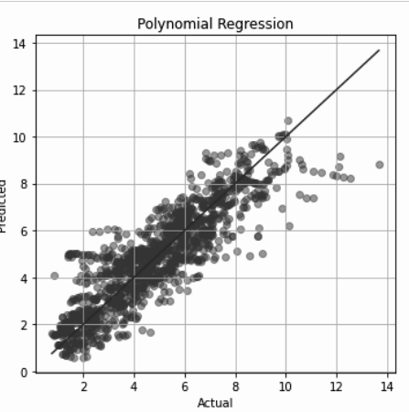
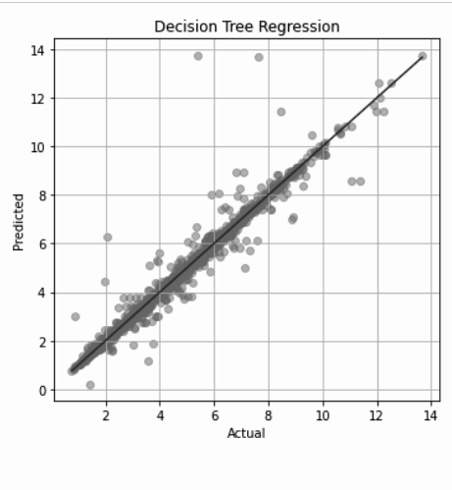
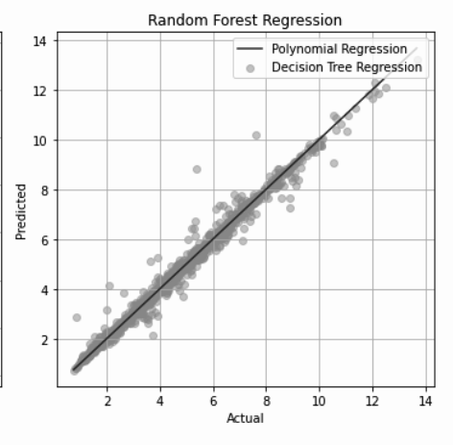
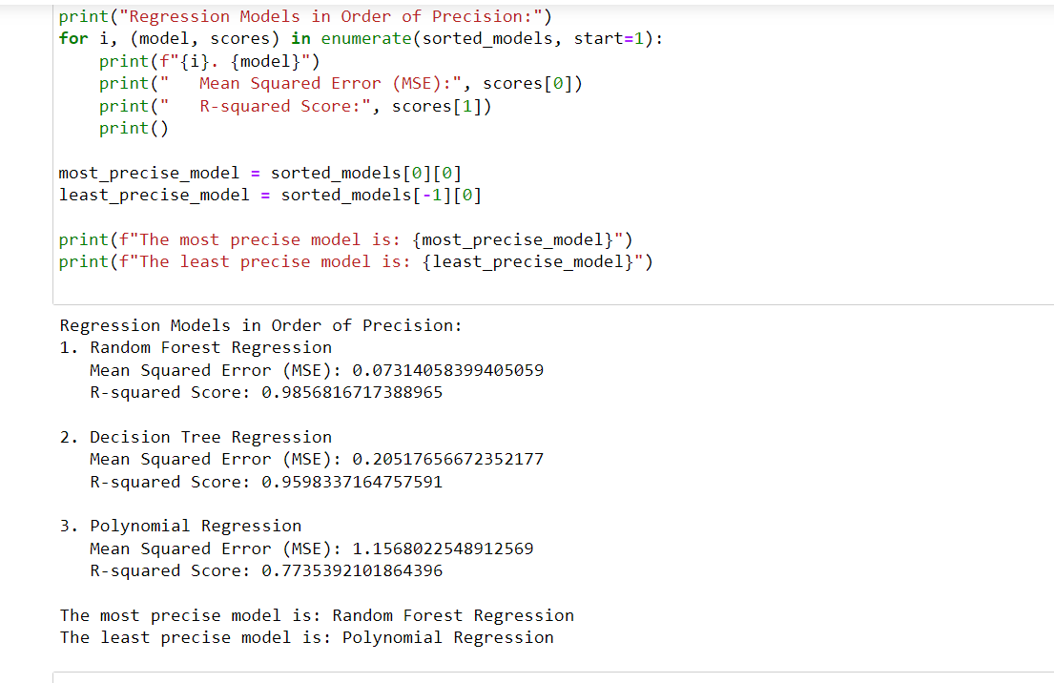

Slide 11
RESULTS
Regression Models in Order of Precision:
1. Random Forest Regression:
Mean Squared Error (MSE): 0.07314058399405059
R-squared Score: 0.9856816717388965
2. Decision Tree Regression:
Mean Squared Error (MSE): 0.20517656672352177
R-squared Score: 0.9598337164757591
3. Polynomial Regression:
Mean Squared Error (MSE): 1.1568022548912569
R-squared Score: 0.7735392101864396
The most precise model is: Random Forest Regression
The least precise model is: Polynomial Regression

Slide 12
LINKS
GitHub Repo: https://github.com/CodeCheck1107/AI_Mental_Fitness_Tracker_AICTE_IBM
Research Papers:
https://shorturl.at/nAL57
https://www.irjmets.com/uploadedfiles/paper/issue_4_april_2022/20946/final/fin_irjmets1650459584.pdf
https://escholarship.org/content/qt9gx593b0/qt9gx593b0_noSplash_d814b6b41c76cb874050695d2bf30ced.pdf

